Slide 1









Revision
$$×$$
$$\frac{1}{2}$$
$$÷$$
$$+$$
$$−$$
$$\frac{3}{5}$$
$$7$$
Name
Class
Teacher
Term 1 Semester 2
$$5^{2}$$
$$\sqrt{9}$$
1

Slide 2

Tasks
24
7
30
Essential Question
Don’t forget to keep your INB up to date
Questions
Notes
You should be ticking these off!
Summary
Have YOU been doing your summaries?
Your book, your responsibility!

Slide 3
Contents
Glossary or Formula Page
Page
Date
Description
2
3

Slide 4





Scientific Notation

Slide 5



Scientific Notation

Slide 6
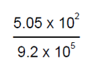

Scientific Notation- Multiplying and Dividing
8 x 9 x 10⁶ x 10⁵
= 72 x 10⁶⁺⁵
= 7.2 x 10¹ x 10¹¹
= 7.2 x 10¹²
5.05 ÷ 9.2 x 10² ÷ 10⁵
= 0.549 x 10²⁻⁵
= 5.49 x 10⁻¹ x 10⁻³
= 5.49 x 10⁻⁴

Slide 7
Statistics
A survey is a collection of data, either primary or secondary.
For primary data, you collect the data yourself.
For secondary data, you get it the data from another source (such as the internet)
The different types of data include categorical, discrete numerical and continuous numerical data
Categorical is data that is sorted by categories (such as type of pet)
Discrete Numerical is data that uses whole numbers (eg number of pets, not footy guernsey no.)
Continuous Numerical is data sorted by numbers that are on a continuous scale (such as height)
In a census, everyone in a population is surveyed.
In a sample, only a section of the population is surveyed.
A census is more accurate but sample are quicker and cheaper.
An outlier is a data point that is an extreme value that skews the data and could be a mistake
A biased survey is one that is unrepresentative because of an unfair sample group or survey question.
Skewed data is when data is more represented on one side of a graph.
Symmetrical data is when the graph forms an even hill shape with one peak (two peaks is bimodal)

Slide 8
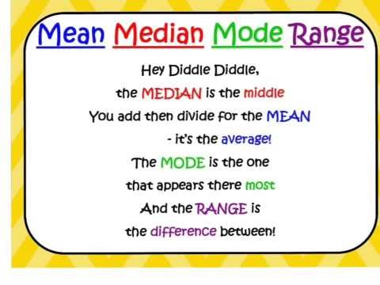

Slide 9
Measures of Location
Example
Diameter of 10 trees randomly selected from Battle Park
9.8, 10.2, 10.1, 14.5, 17.5, 13.9, 20.0, 15.5, 7.8, 24.5
Mean
Median: 7.8, 9.8, 10.1, 10.2, 13.9, 14.5, 15.5, 17.5, 20.0, 24.5
Mode
No Mode
Range 24.5 – 7.8 = 16.7

Slide 10
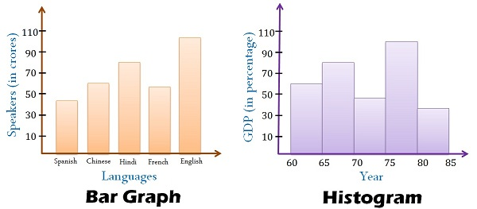
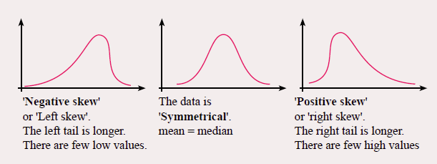
A histogram looks like a column graph but is for continuous numerical data. The data are placed into columns based on intervals rather than categories.
Gaps
No Gaps
Data is categorical and bars can be swapped around
Data is continuous numerical and columns cannot be swapped around

Slide 11
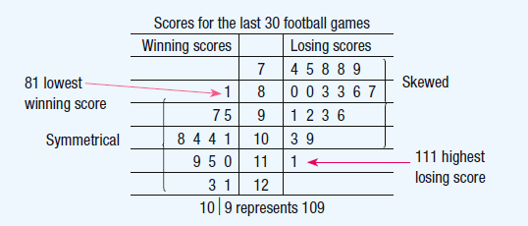
Back to Back Stem & Leaf Plots
Back to back stem and leaf plots are used to display two groups of data together in the one plot. It is used primary to compare data.
The groups are displayed separately but share a common stem. One group is displayed on the left hand side, the other on the right hand side.

Slide 12
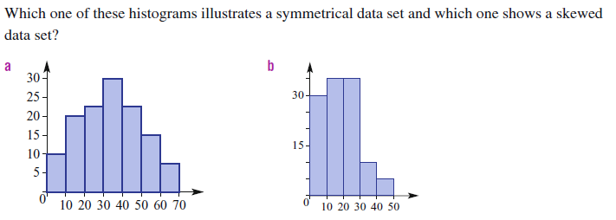
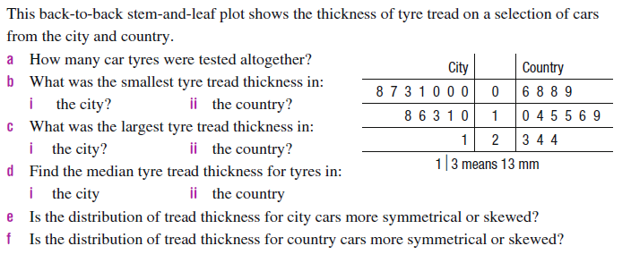
Try these questions

Slide 13
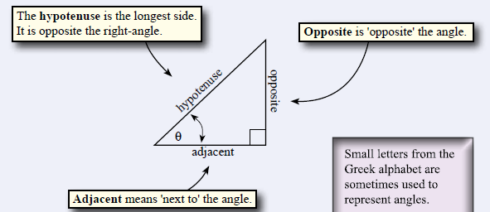
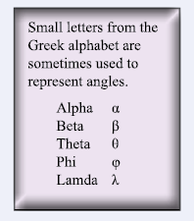
Trigonometry

Slide 14
24
7
30
Date
Trigonometry
EQ – How do you use the tangent, sine and cosine formulae to find missing sides ?
What are the steps for finding a missing side in trigonometry?
1. Identify which trigonometric function is needed
x
SOHCAHTOA!!!
ϴ
y
2. Substitute the numbers into the correct places
Sin ϴ =
Opposite
Hypotenuse
Opposite is the line that doesn’t form the angle
3. Rearrange the equation so that the unknown is on one side
Cos ϴ =
Adjacent
Hypotenuse
Switch Sides, Switch Signs
Tanϴ =
Opposite
Adjacent
4. Calculate the answer
Note: tan ϴ × y must be typed in as (tan ϴ) × y
5

Slide 15
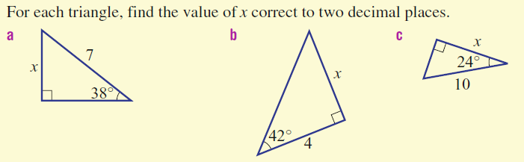
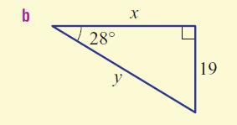
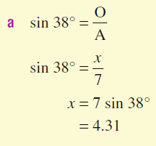
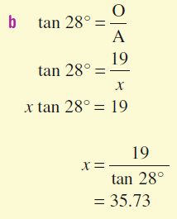
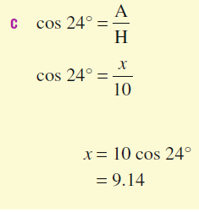
Let’s try some together

Slide 16
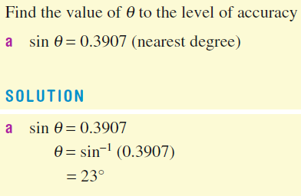
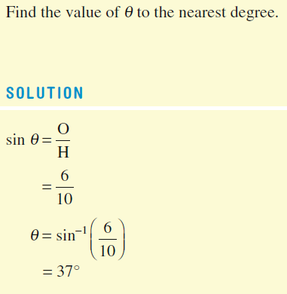
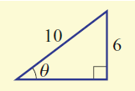
Finding the angle

Slide 17
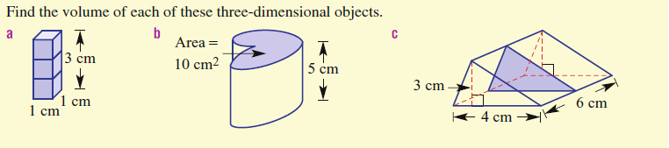


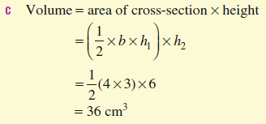
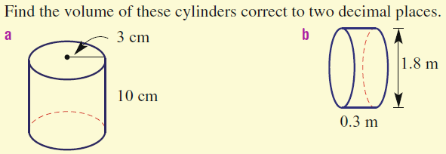
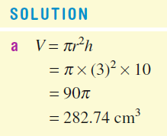
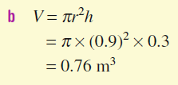
Volume

Slide 18
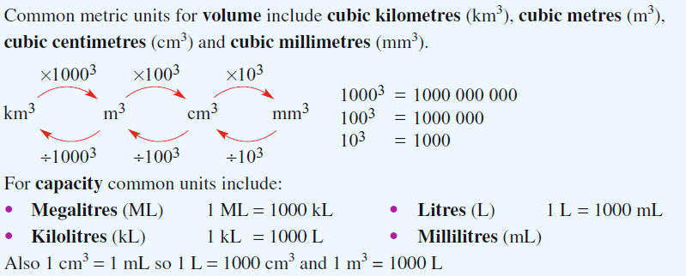
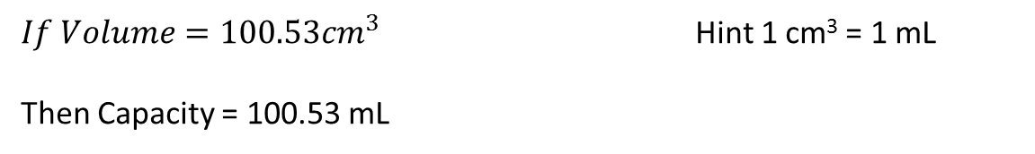
Capacity and Conversions
Capacity is the amount of liquid can fit inside a shape. For instance, how much water can fit inside a cup.
To calculate capacity, find the volume and convert it from volume units (eg cm³) to capacity (eg ml)
$If Volume=100.53{cm}^{3}$ Hint 1 cm³ = 1 mL
Then Capacity = 100.53 mL

Slide 19
Now you try
Exericse 15.2 Page 206 (Dwyer Book)
Q2 (g) and (h)
Q3 – 17
Exercise 9.16 Page 133 (Dwyer Book)-Stats

Slide 20
Notes Review
24, 7 ,30
Date
Title
Essential question
Notes complete
Notes complete with colour and diagrams
Questions completed
Contents page filed in
Formula page filled in

Slide 21
Homework
Review your notes and write a summary answering the essential question.

